Slide 1
Weekly Update #2
Gijs Admiraal

Slide 2
Recap from previous weeks
Started exploring topics: atom-by-atom generation, non-standard amino acids, (chemical) language models
Summarized “Atom-by-atom protein generation and beyond with language models”
Started exploring SMILES trough RDKit tutorial
Created a mind map

Slide 3
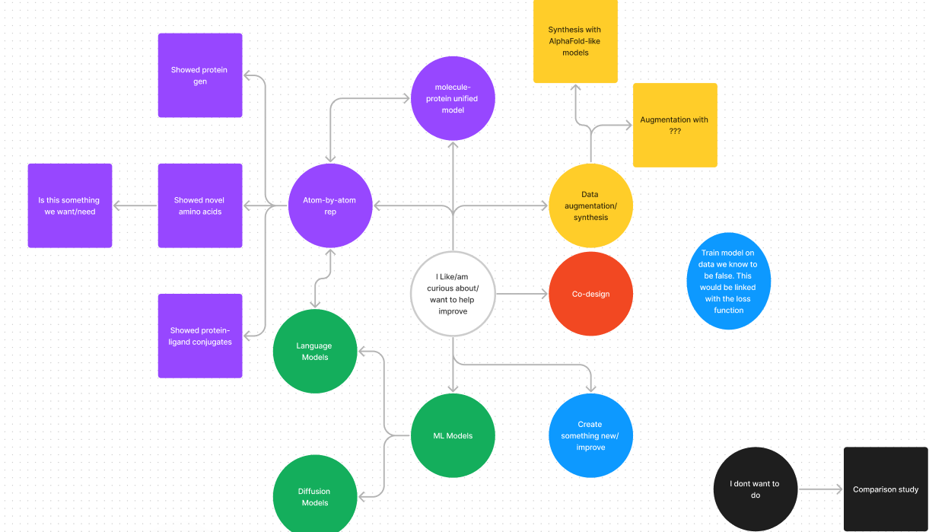
Mind map

Slide 4
What I have done
Explored non-standard amino acid (nsAA) generation
Found existing research with nsAA created in wet labs but research does not include cs background
“Xenobiology in synthetic biology: From non-standard amino acid incorporation to biosecurity implications”
Verifying is hard since no dataset/benchmark exists and can’t use AF2-like methods
Thus, determined that for me is not a right path to pursue
Explored LMs for protein design
Have not found an LM that can do structure prediction only structure property prediction
Explored data augmentation for protein sequences
“Improving generalizability of protein sequence models with data augmentations”
Uses self-supervised and contrastive learning
“Nucleotide augmentation for machine learning-guided protein engineering”
More focused on nucleotide augmentation
Send email to Flam-Shepherd
Follow up + code available early next year
Open for both a meeting or my questions document

Slide 5
What I have done
Explored non-standard amino acid (nsAA) generation
Found existing research with nsAA created in wet labs but research does not include cs background
“Xenobiology in synthetic biology: From non-standard amino acid incorporation to biosecurity implications”
Verifying is hard since no dataset/benchmark exists and can’t use AF2-like methods
Thus, determined that for me is not a right path to pursue
Explored LMs for protein design
Have not found an LM that can do structure prediction only structure property prediction
Explored data augmentation for protein sequences
“Improving generalizability of protein sequence models with data augmentations”
Uses self-supervised and contrastive learning
“Nucleotide augmentation for machine learning-guided protein engineering”
More focused on nucleotide augmentation
Send email to Flam-Shepherd
Follow up + code available early next year
Open for both a meeting or my questions document

Slide 6
What I have done
Explored non-standard amino acid (nsAA) generation
Found existing research with nsAA created in wet labs but research does not include cs background
“Xenobiology in synthetic biology: From non-standard amino acid incorporation to biosecurity implications”
Verifying is hard since no dataset/benchmark exists and can’t use AF2-like methods
Thus, determined that for me is not a right path to pursue
Explored LMs for protein design
Have not found an LM that can do structure prediction only structure property prediction
Explored data augmentation for protein sequences
“Improving generalizability of protein sequence models with data augmentations”
Uses self-supervised and contrastive learning
“Nucleotide augmentation for machine learning-guided protein engineering”
More focused on nucleotide augmentation
Send email to Flam-Shepherd
Follow up + code available early next year
Open for both a meeting or my questions document

Slide 7
What I have done
Explored non-standard amino acid (nsAA) generation
Found existing research with nsAA created in wet labs but research does not include cs background
“Xenobiology in synthetic biology: From non-standard amino acid incorporation to biosecurity implications”
Verifying is hard since no dataset/benchmark exists and can’t use AF2-like methods
Thus, determined that for me is not a right path to pursue
Explored LMs for protein design
Have not found an LM that can do structure prediction only structure property prediction
Explored data augmentation for protein sequences
“Improving generalizability of protein sequence models with data augmentations”
Uses self-supervised and contrastive learning
“Nucleotide augmentation for machine learning-guided protein engineering”
More focused on nucleotide augmentation
Send email to Flam-Shepherd
Follow up + code available early next year
Open for both a meeting or my questions document

Slide 8
What I haven’t done
Data analysis
Look at codes
Summarize other flam-shepherd paper
Write about/understand (chemical) language models

Slide 9
Questions
How to start working effectively – I feel like I had two unproductive weeks
Choosing and setting goals
Find a direction I want to work towards

Slide 10
Next week?
Compile and send list of questions
Maybe questions about details in a list and more open questions in the meeting?
Away to Stockholm until the 7th of December

Slide 11
notes
Can LM be used with diffusion

